Slide 1
Navigation Deck for Performance Goal Setting Process in Goal Center

Slide 2
Goal Setting – Process Workflow
Navigation: Log in to Tata Play Universe → Me → Career and Performance → Goal Center.
Copy Previous Goals: Use the “Copy previous goals” button to import goals from the last FY.
Add New Goals:
  Click “Add” to create new goals.
  Fill in goal name, description, success criteria/milestones.
  Use AI Assist for goal detail suggestions.
  Ensure total weightage equals 100%; adjust if needed.
  Click “Submit” to send goals for approval.
Goal Modification
  Goals and weights can be added/modified anytime before the appraisal process via the Goal Center.

Slide 3
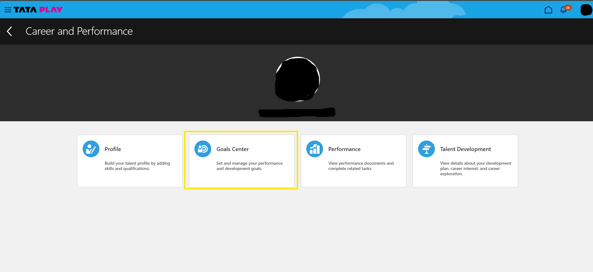
Navigation to Goals Module
Navigation: Log in to Tata Play Universe → Me → Career and Performance → Goal Center.
Copy Previous Goals: Use the “Copy previous goals” button to import goals from the last FY.
Add New Goals:
  Click “Add” to create new goals.
  Fill in goal name, description, success criteria/milestones.
  Use AI Assist for goal detail suggestions.
  Ensure total weightage equals 100%; adjust if needed.
  Click “Submit” to send goals for approval.

Slide 4
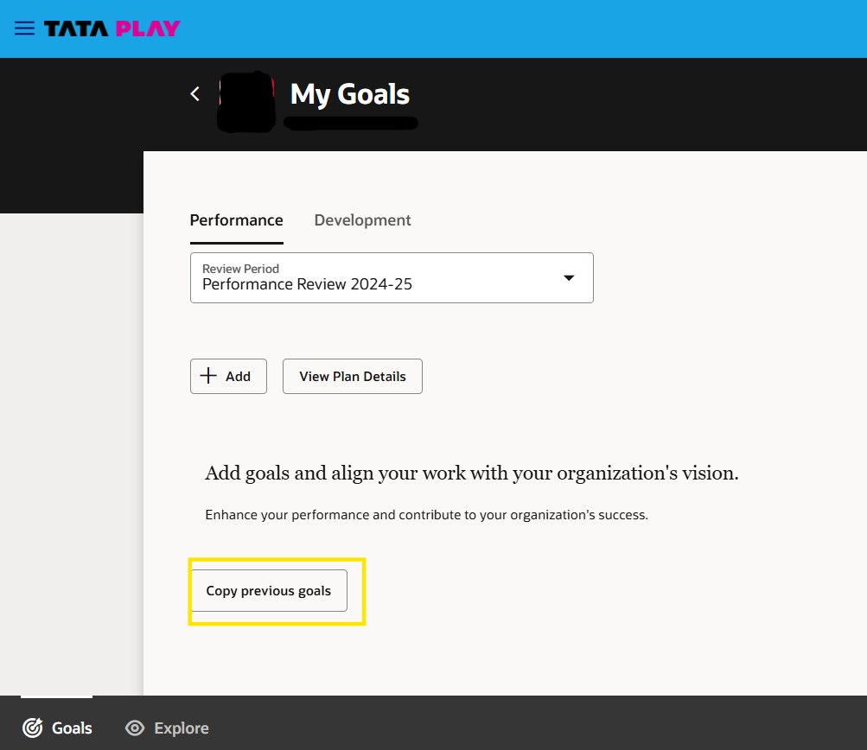
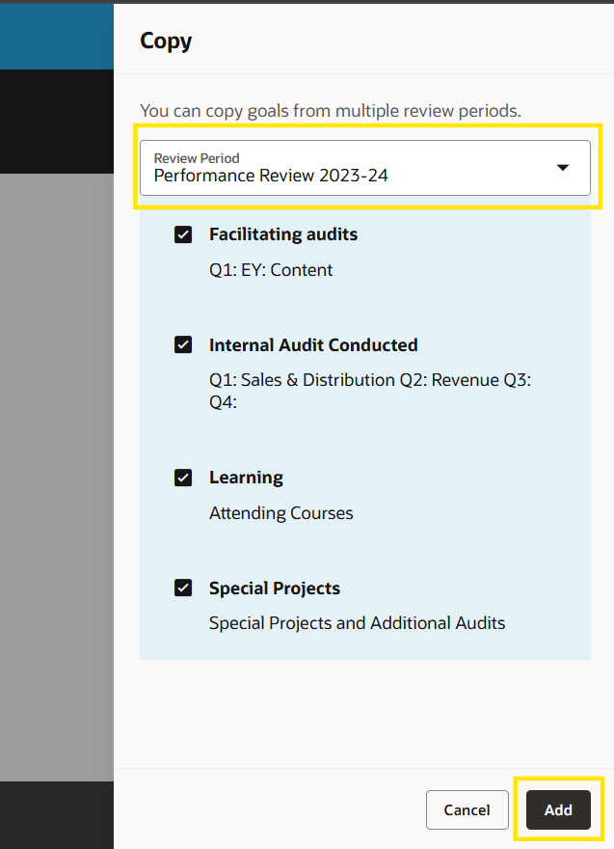
Previous Years FY Goals
To Copy previous FY goals click on ‘Copy previous goals’ button.
Then select the review period and goals you want to copy then click on ‘Add’

Slide 5
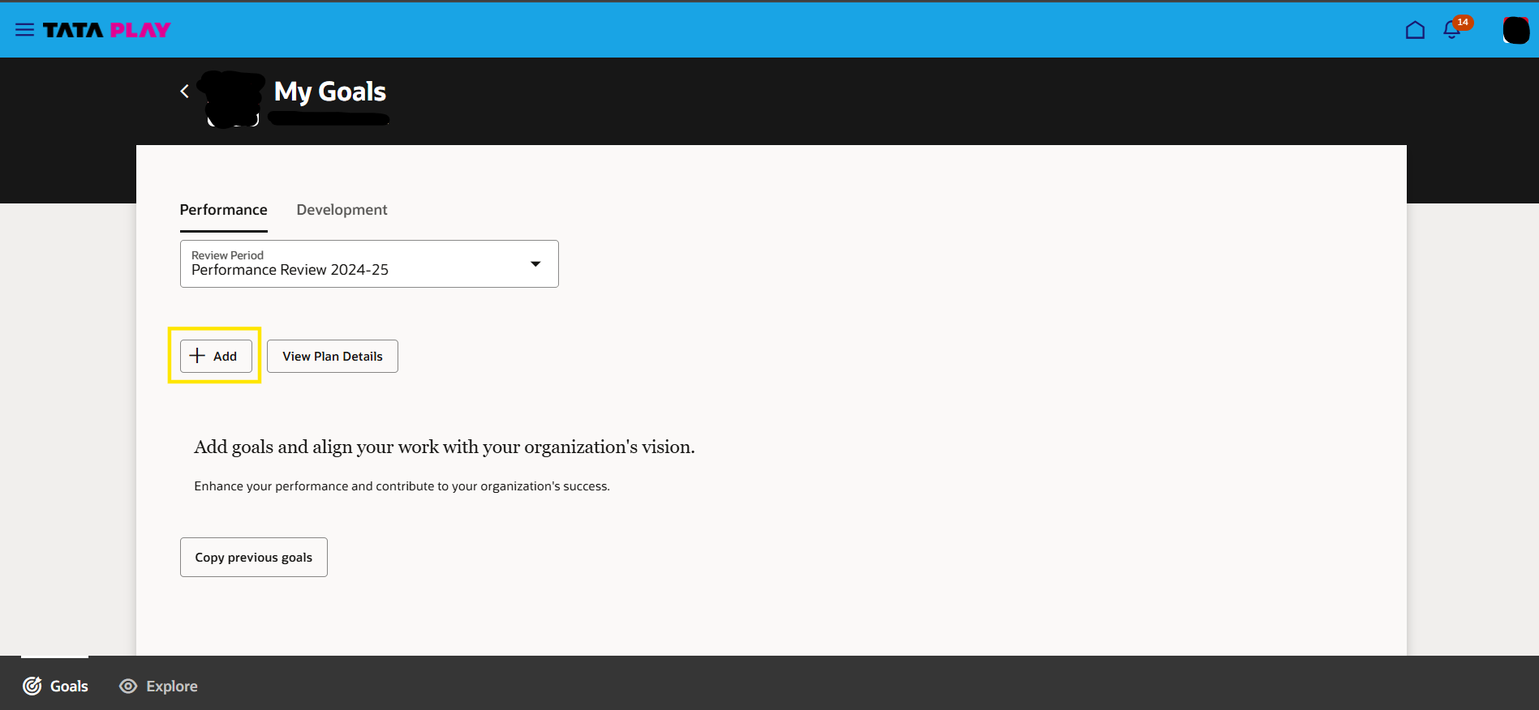
Addition of new goals
To add new goals click on the ‘Add’ button

Slide 6
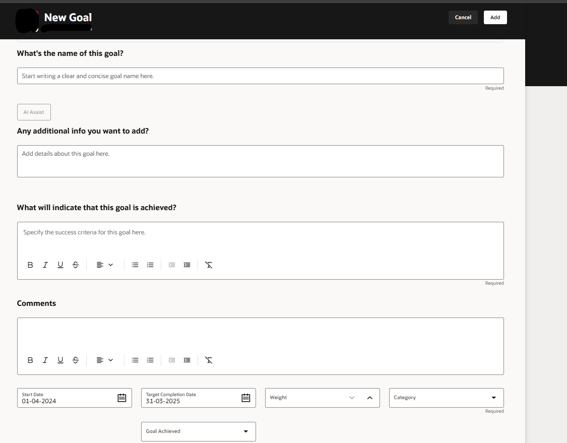
Addition of Goal
Fill the Goal details in the Add Goal form
Can click on “AI Assist” to generate goal details
Write goal name here
*(New) Click on the AI assist to generate a sample goal. Please modify this basis goal requirement
Success criteria or Milestone
Goal Description

Slide 7
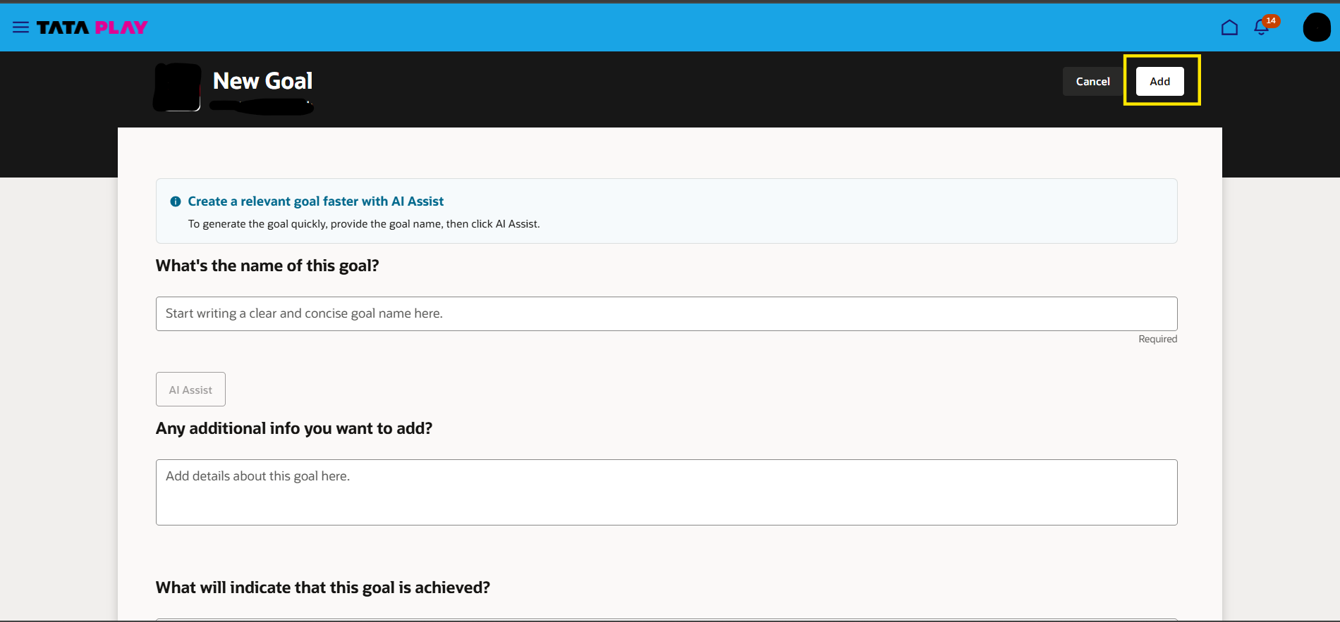
Addition of Goal
After filling goal details click on ‘Add’

Slide 8
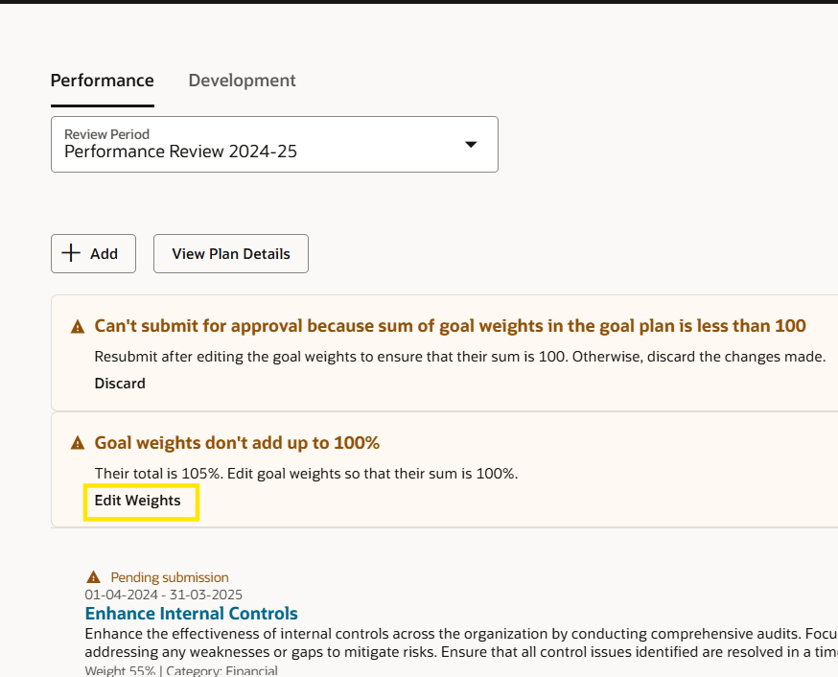
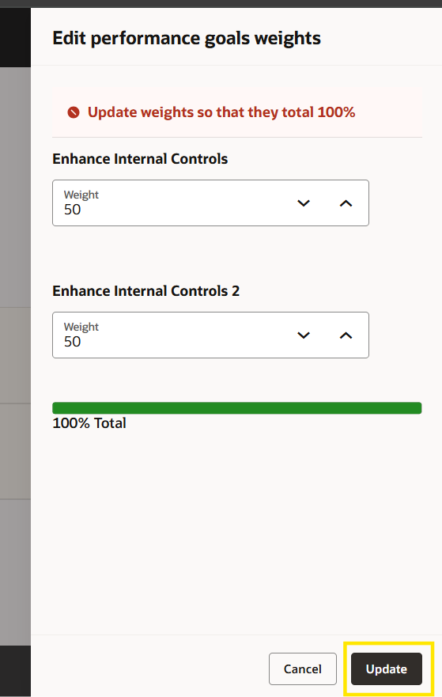
Addition of Goal
Repeat the previous steps for all the goals and make sure the weights adds up to 100%. If not below warning message will be shown. In the warning click on edit weights to balance the weights to 100%

Slide 9
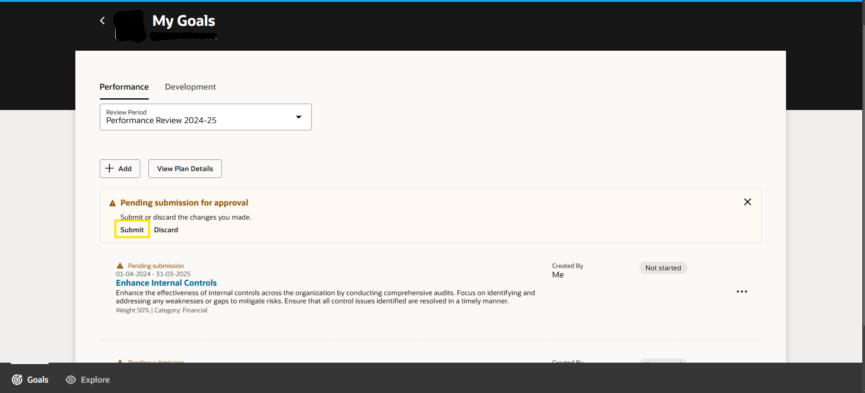
Submission of Goals
Once everything is done click on ‘Submit’ to submit the goals for approval.

Slide 10

Manager Approval

Slide 11
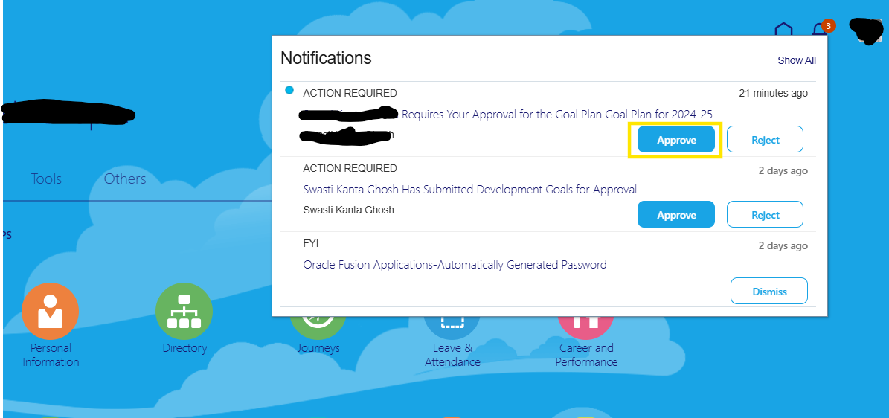
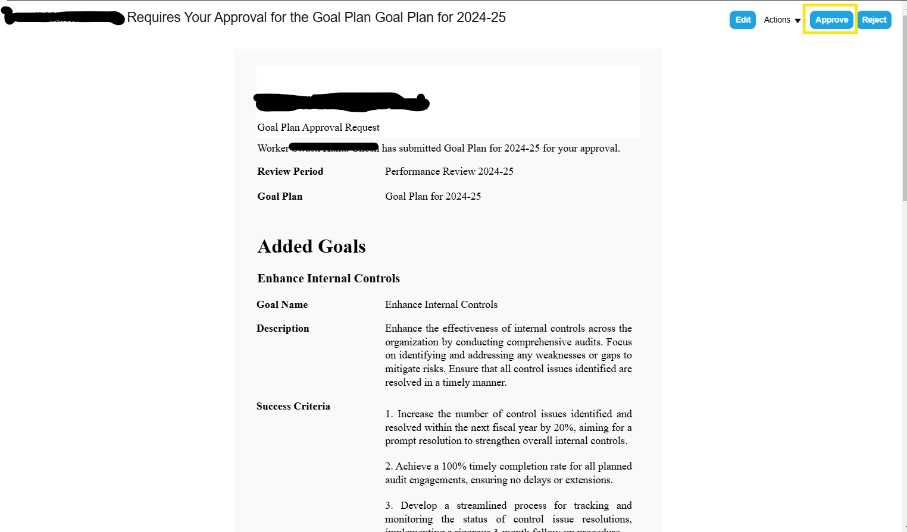
Manager Approval – Process Workflow
Once the Employee has submitted his/her goals for approval a notification will trigger to line manager to approve the same.
There are three ways to approve goals,
  1. Approving directly from the notification, as shown below.
  2. By opening the Notification and then approving the same.
  3. Approving from ‘Team Goals Center’
  Manager selects employee → views details → clicks “Approve” → “Submit”.

Slide 12
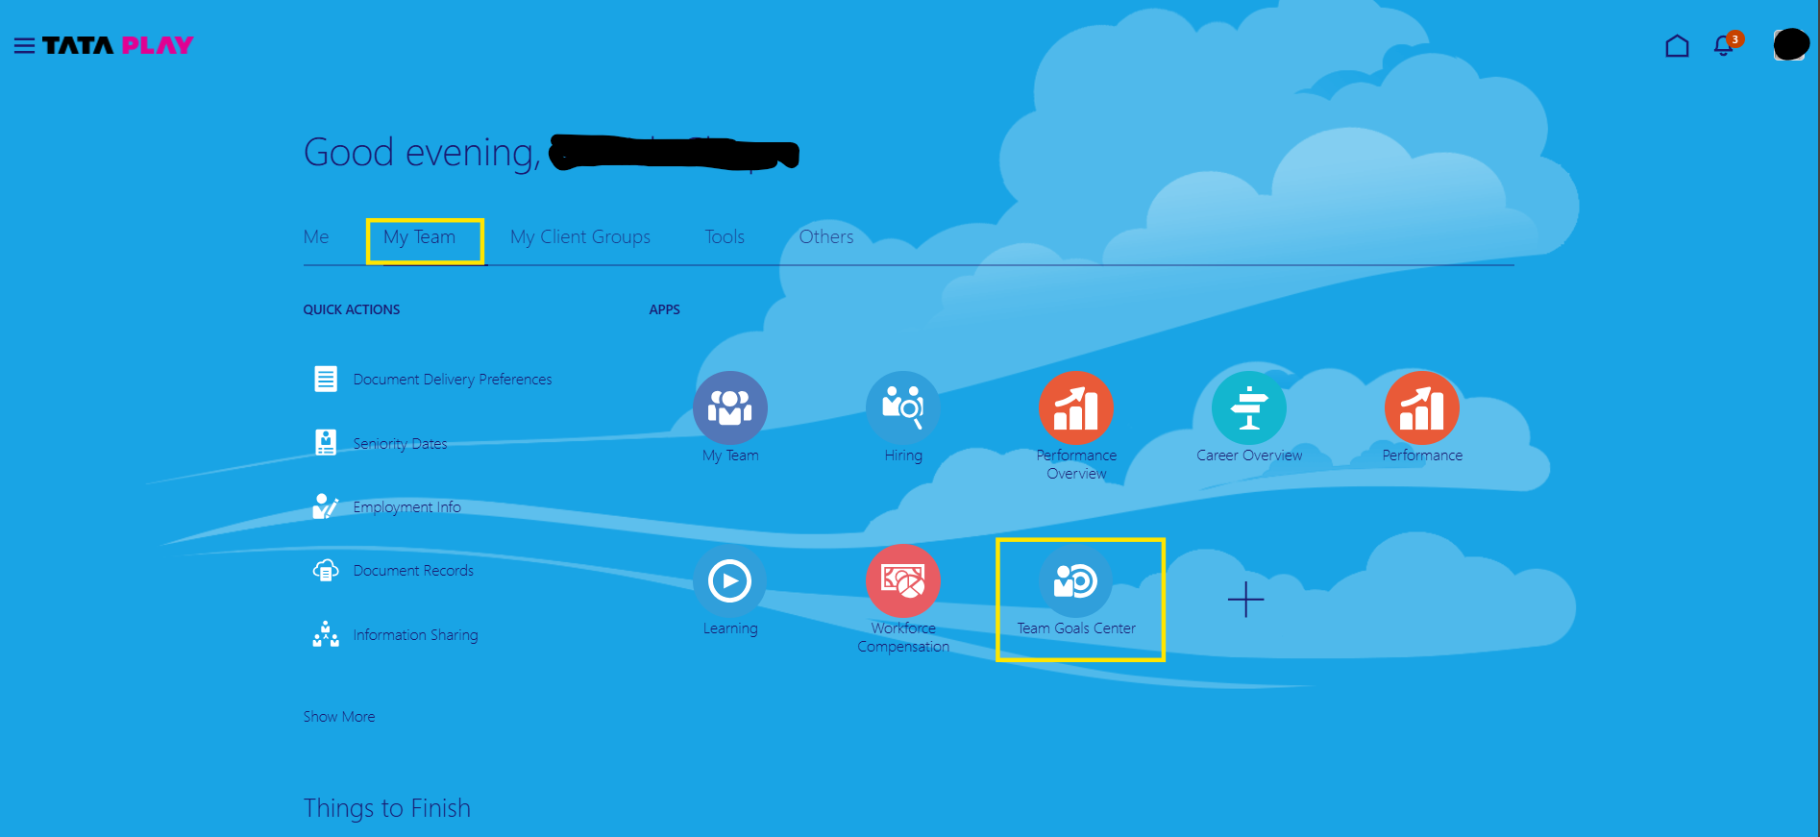
Approving from ‘Team Goals Center’. Click on My Team > Team Goals Center

Slide 13
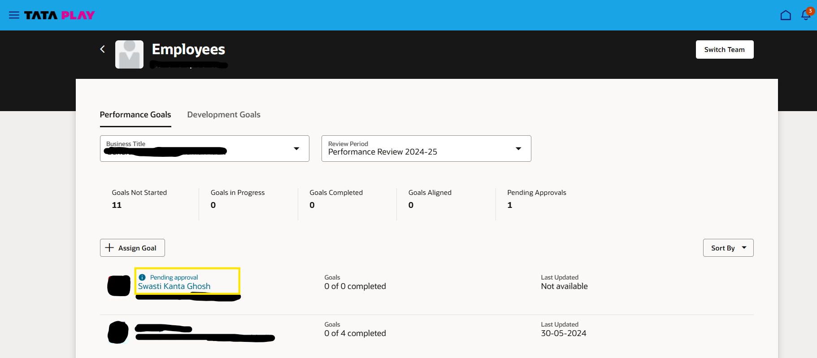
Click on the Employee name for whom manager approval is pending.
Employee Name

Slide 14
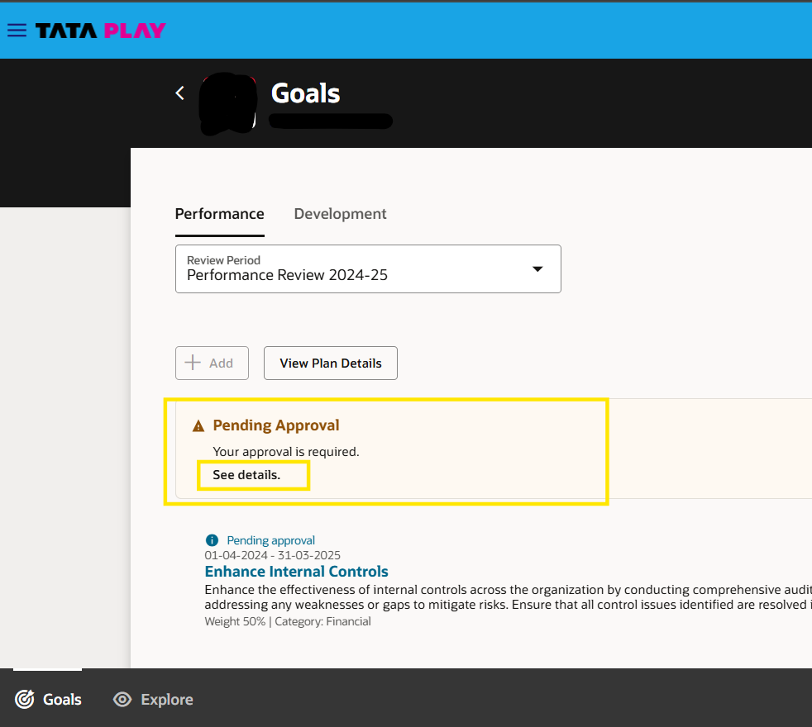
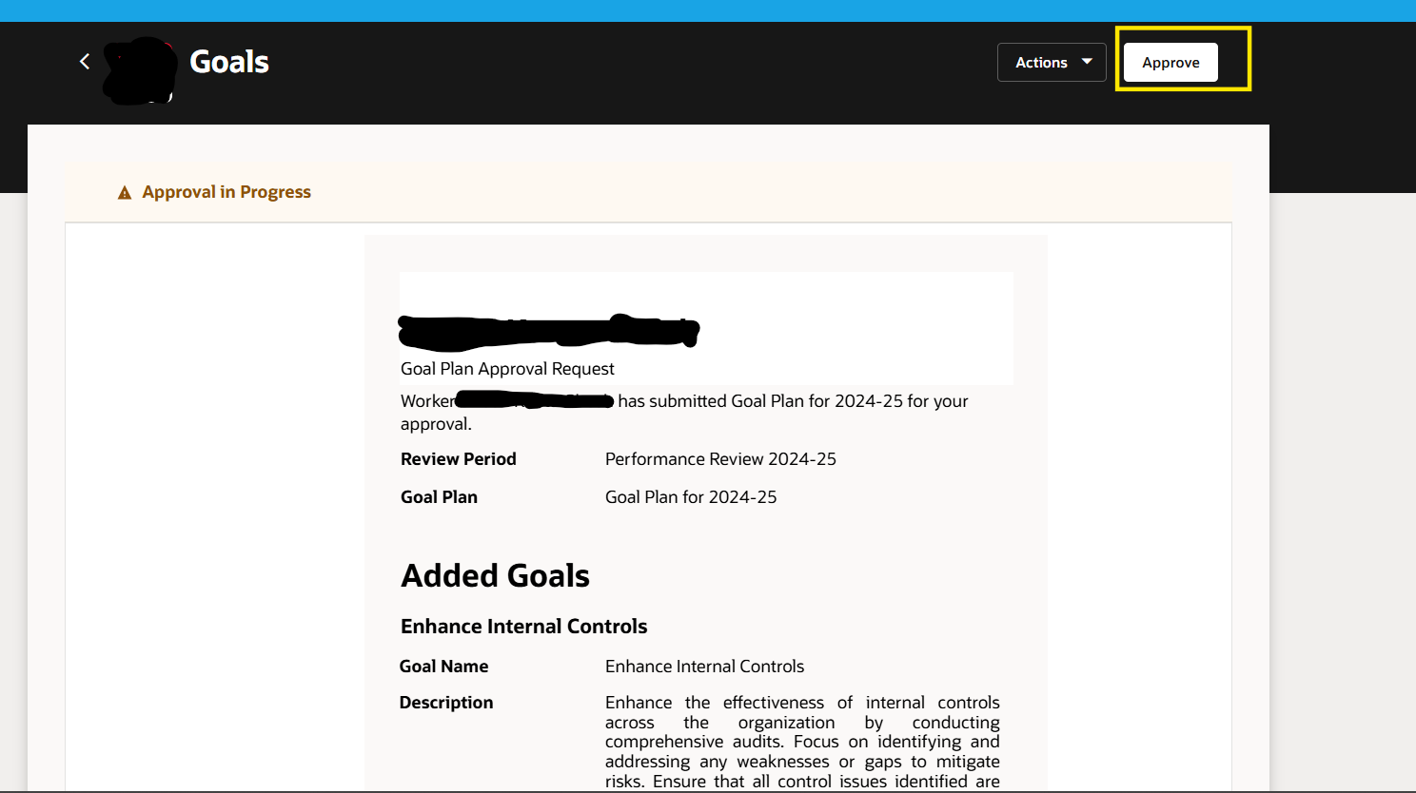
Click on ‘See details.’ on the Pending Approval section. Then click on ‘Approve’

Slide 15
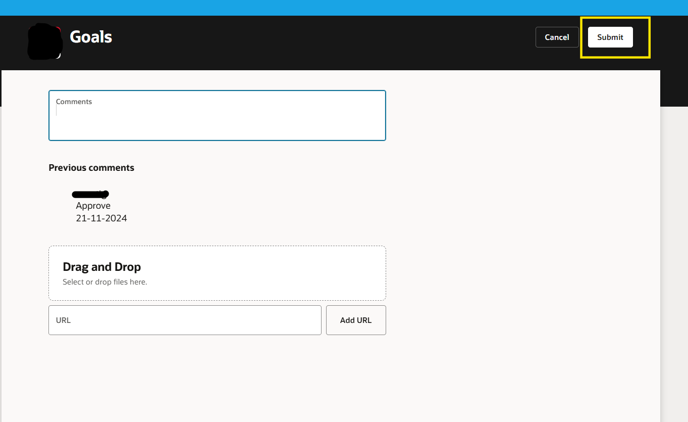
Click on ‘Submit’.

Slide 16
Reviewer Approval

Slide 17
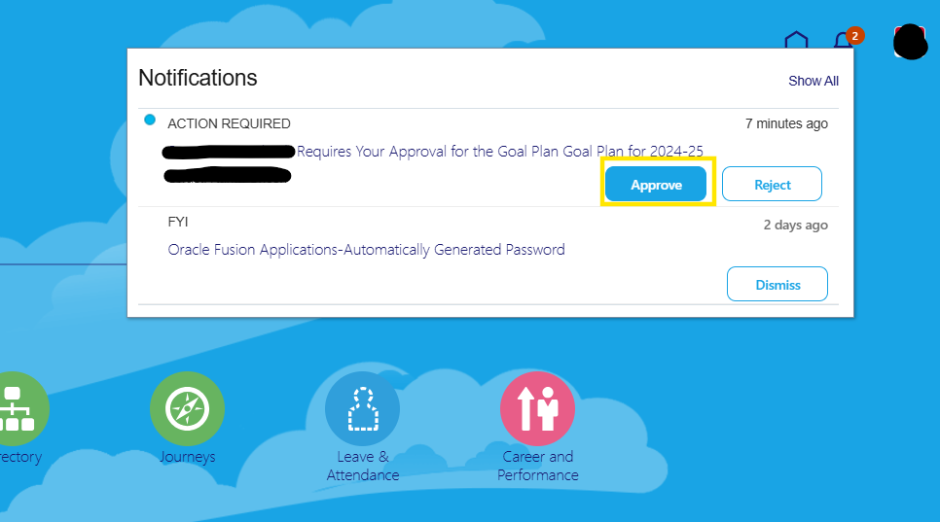
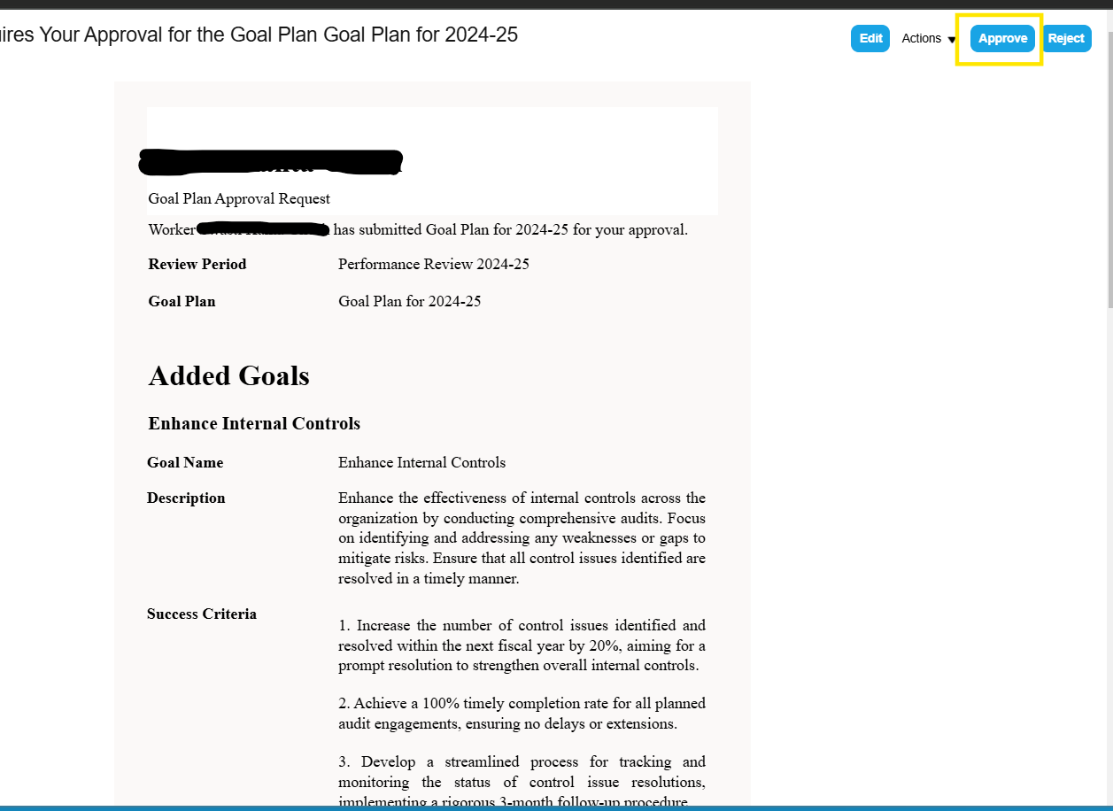
Once the Line Manager has approved the Goals then it will go for Reviewer’s approval.
Reviewer can Approve the Goals by opening the approval notification as below.

Slide 18
Other Activities done by Employee On ‘Goal Center’ throughout the FY

Slide 19
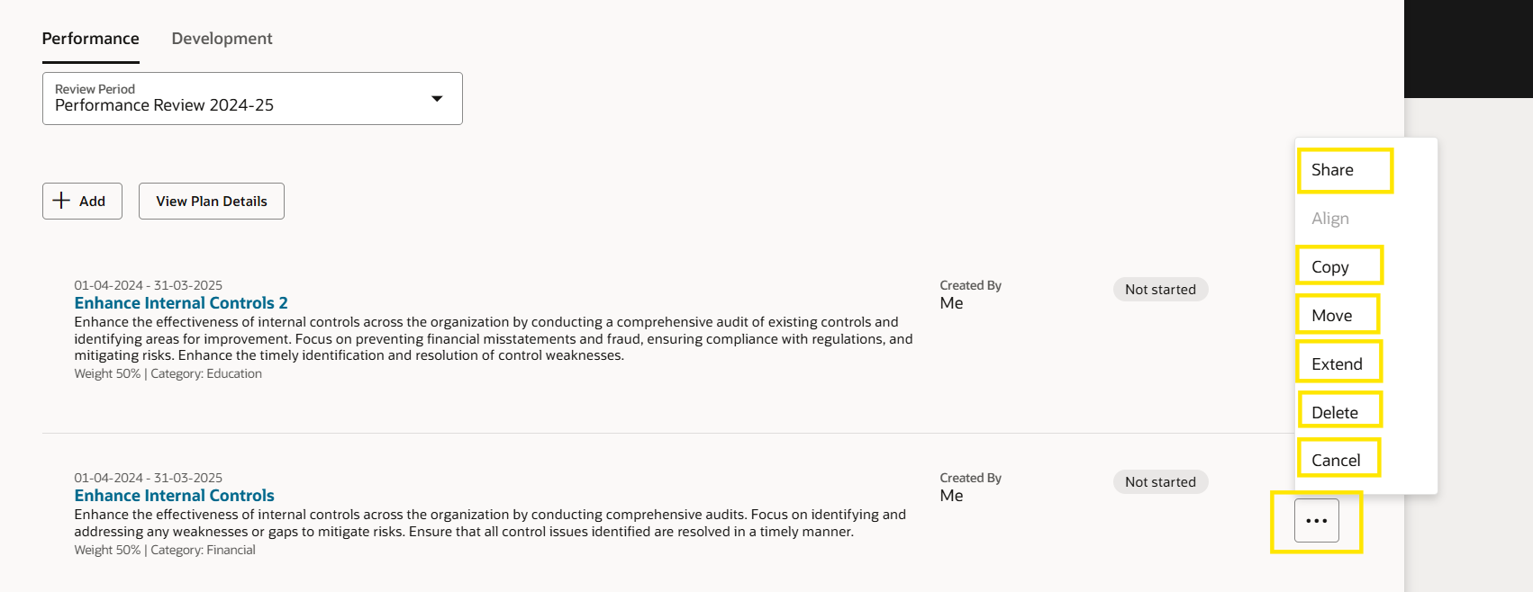
Me > Career and Performance > Goal Center
Various Actions Employee can perform on a performance goals as below.
2. Copy – Copy the goal to another review period and goal plan
3. Move – Move the goal to another review period and goal plan
4. Extend – Extend in-progress goals to next review period and goal plan
5. Delete – Delete the Performance Goal
6. Cancel – Cancel the Performance Goal
Click on the three dot right next to a Performance Goal

Slide 20
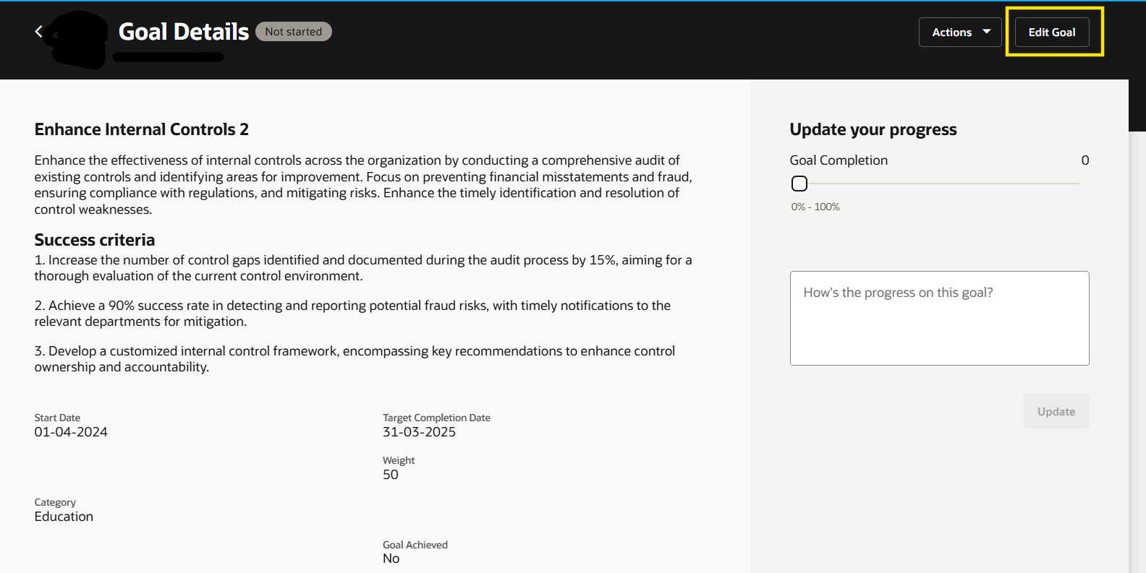
Edit a Performance Goal
Me > Career and Performance > Goal Center > Click on the Goal > Edit Goal

Slide 21
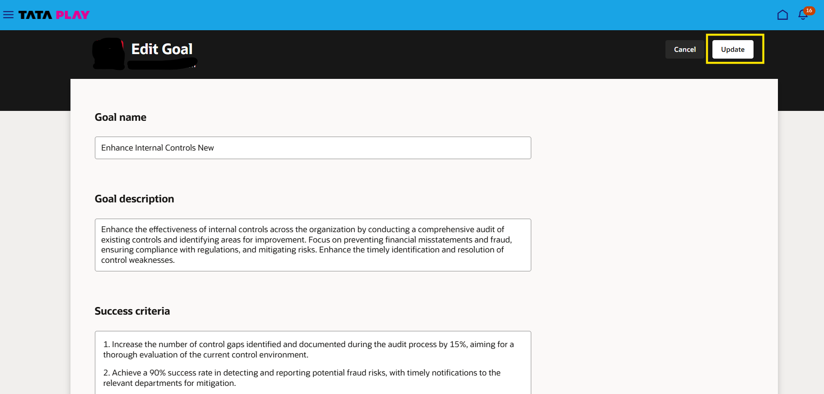
Make Edits to Goal Details and Click ‘Update’

Slide 22
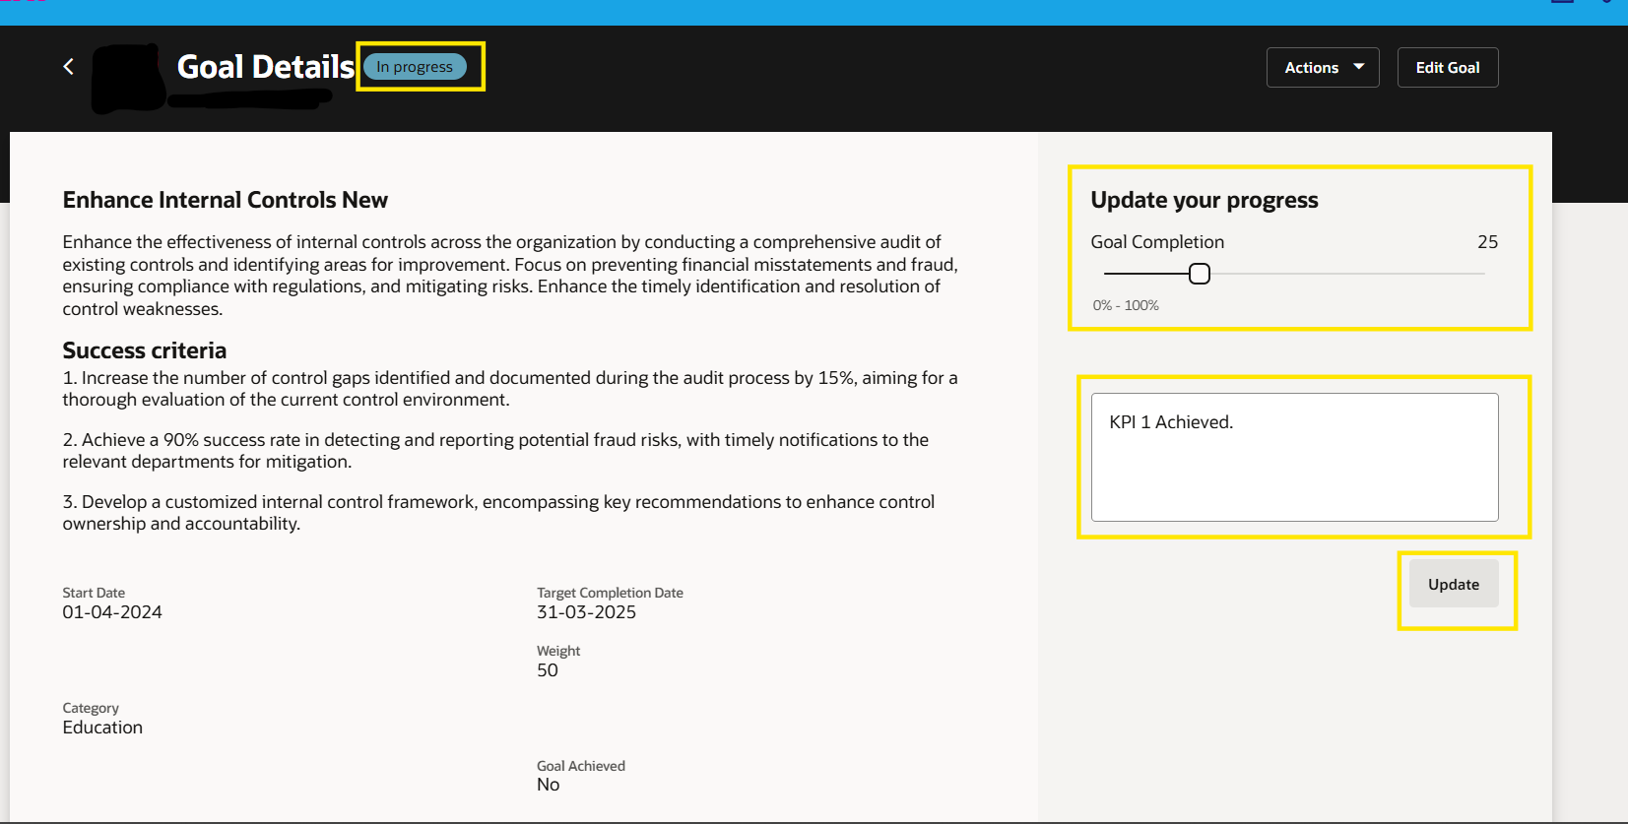
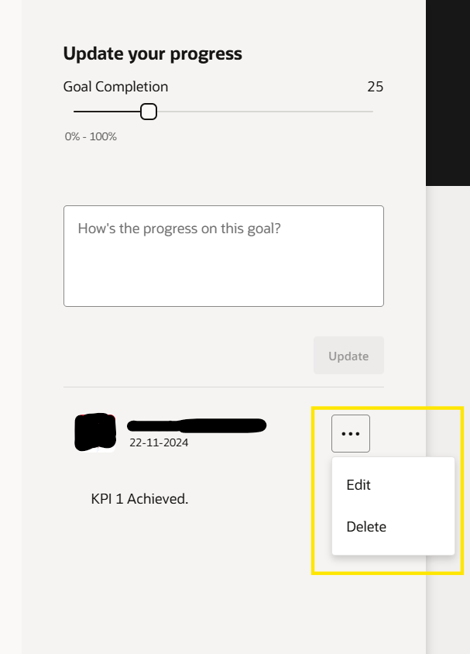
Update Goal Progress and Add Progress Notes
Me > Career and Performance > Goal Center > Click on the Goal Name
1. Update Goal Progress in the slider to make the goal status In-Progress
2. Add Progress Notes in the text box and click on ‘Update’
3. To Edit/Delete progress note click the three-dot next to a note and click Edit/Delete

Slide 23
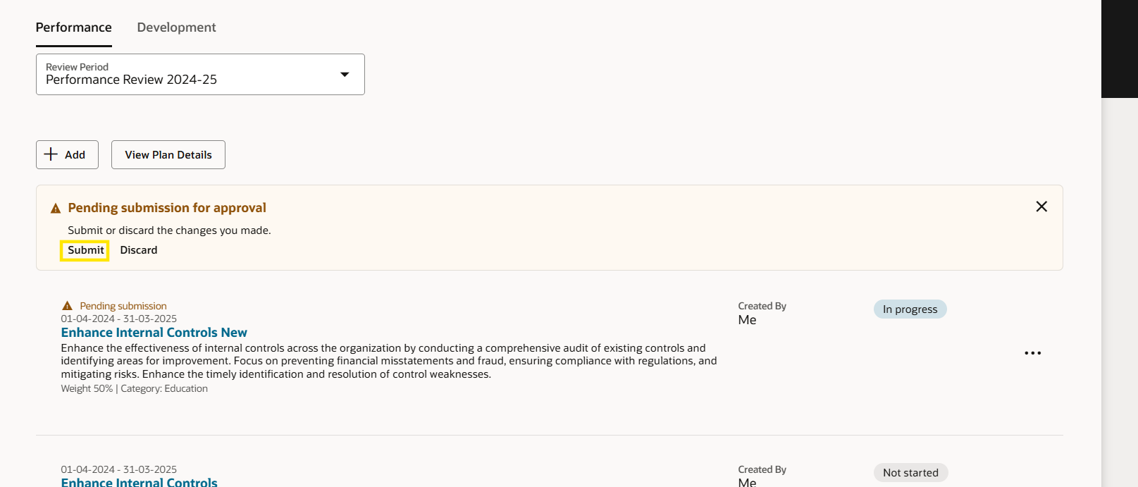
After all the necessary updated are done click on ‘Submit’ to send for approval.

